Slide 1
Personal Requirement
CH # 4
(Facility System design, support system)

Slide 2
4.4. Food Services
Food service activities may be viewed by a firm as a necessity, a convenience, or a luxury. The viewpoint adopted, as well as a firm’s policy on off-promises dining, subsidizing the costs of meals and the amount of time allowed for meals, has a significant impact on the planning of food service facilities.
Food service facilities should be planned by considering the number of employees who eat in the facilities during peak activity time. Kitchen facilities should be planned by considering the total number of meals to be served.
Example:
If a facility employ 600 people and they are to eat in three equal 30-min shifts, how much space should be planned for a cafeteria with vending machines, serving lines, or a full kitchen?

Slide 3
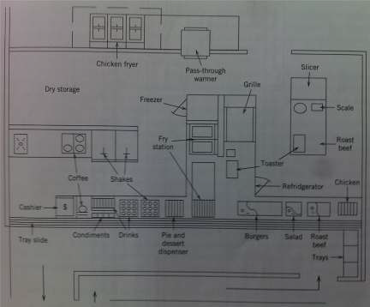
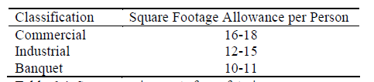
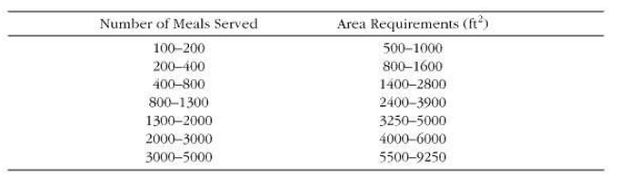
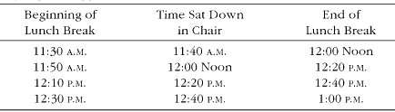
For vending machines purposes 1 ft2 per person should be allowed for the vending machine area, based on the maximum number of persons eating at one time.
If a facility employs over 200 people, a serving line is a feasible alternative. A typical industrial service line requires 300 ft2 and can service seven employees per minute
Shifting timing for 30-min lunch breaks
Space required for full kitchens

Slide 4
4.5. Health Services
The types of health services that may be provided within a facility include
1. Pre-employment examinations,
2. First aid treatment,
3. Major medical treatment,
4. Dental care, and
5. Treatment of illnesses.
The minimal requirements for a first aid room are an approved first aid kit, a bed, and two chairs. A minimum of 100 ft2 is required. If a nurse is to be employed, the first aid room should have two beds and should be expanded to 250 ft2.

Slide 5
4.6 Barrier-Free Compliance
As per Factories Act 1934, Pakistani companies must employed Disable persons. The intent is to ensure that disabled persons shall have the same rights as the able-bodied to the full and free use of all facilities that serve the public
The facilities planner must recognize that this applies to all public facility use groups:
• Assembly
• Business
• Educational
• Factories and industrial
• Institutional.

Slide 6
4.7 Office Facility Planning
Offices are the among the most challenging facilities to plan. One reason for the is each office employees has an option on how much space should be planned. The Important concepts to be considered is
Approaches to Office Planning
Area Requirement
Type of Organization Matrix

Slide 7
